Slide 1
Generative models and inverse design
Seminar: Machine learning in the natural sciences
Tahar Chettaoui B.Sc.
Supervisor: Jun.-Prof. Dr. Pascal Friederich

Slide 2
Outline
Why are some hand sanitizer gels so sticky?
Undiscovered molecules
How can we discover new molecules?
Can AI help solve this problem?
Generative models and inverse design
SMILES representations
System architecture
Experiments & results

Slide 3

Why are some hand sanitizer gels so sticky?

Slide 4
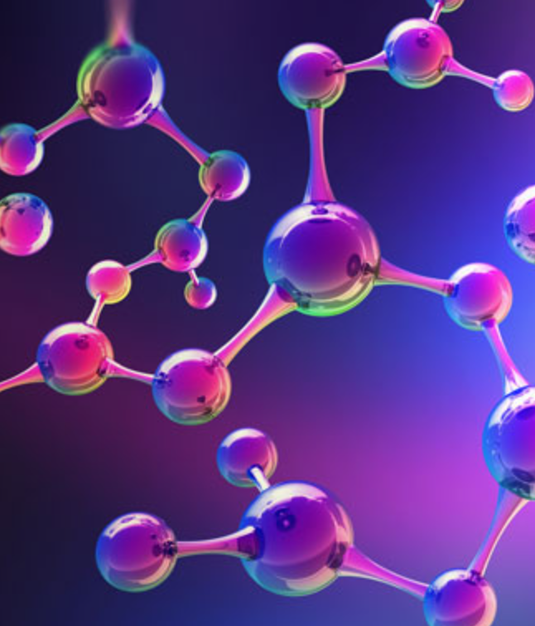
Undiscovered molecules
Goal of drug and material design is to identify new molecules with desirable properties.
About 10⁸ substances have been synthesized¹
https://www.surveymonkey.de/r/WQP98CH ²
Types of Drug design:
Structure-based (SBDD)
Ligand-based (LBDD)
Figure 1. Molecules
Molecules, The college of Letters & Science

Slide 5
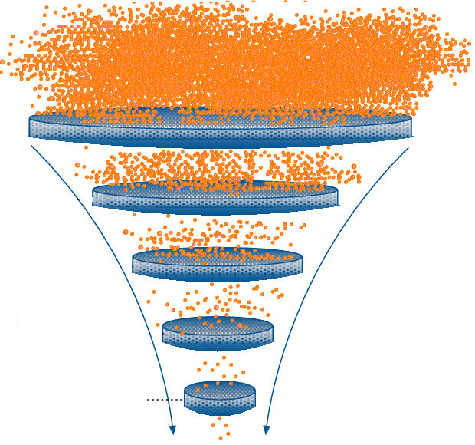

Structure-based drug design & Ligand-based drug design
Virtual Screening (VS) search libraries of molecules to identify substances with desired properties.
Structure-based design relies on knowledge of the 3D structure of the target
Ligand-based design relies on knowledge of other molecules close to the target
RL
GAN
VAE
Figure 2. Virtual screening filtering

Slide 6
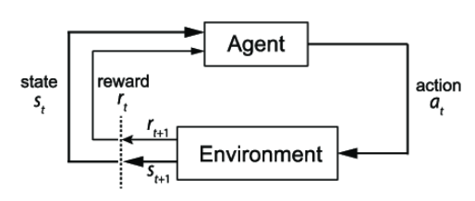
ReLeaSE – Reinforcement learning based
Agent: learn how to take actions to maximize the reward
Environment: the agent’s world in which it lives and interacts
Figure 3. RL Scheme

Slide 7
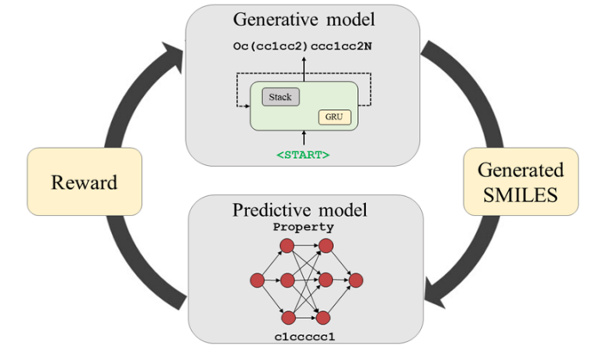
ReLeaSE – System pipeline
Figure 4. ReLeaSE system pipeline⁹
ReLeaSE, 10.1126/sciadv.aap7885

Slide 8
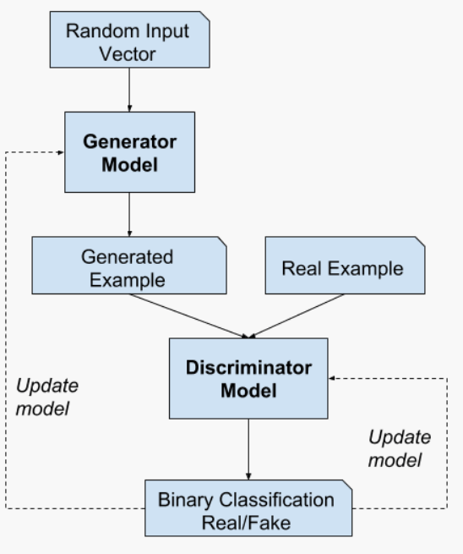
ORGAN – GAN based
GAN Generator and discriminator compete
Figure 5. GANs System Architecture

Slide 9
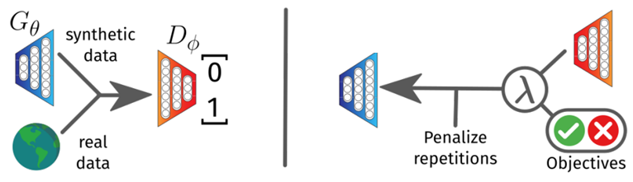
ORGAN – System pipeline
ORGAN¹⁰ combines GANs and RL
GAN RL
Figure 6. ORGAN Architecture¹⁰
ORGAN, https://arxiv.org/abs/1705.10843

Slide 10
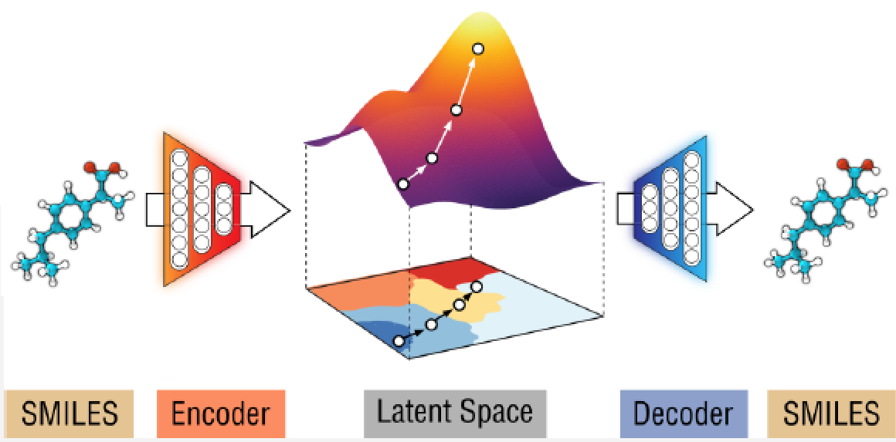
Variational autoencoder as generative model
This model allows us to generate new molecules for efficient exploration of molecules
It converts discrete representations of molecules to and from a multidimensional continuous representation
Figure 7. VAE jointly-trained on properties⁶
Automatic Chemical Design, 10.1021/acscentsci.7b00572

Slide 11
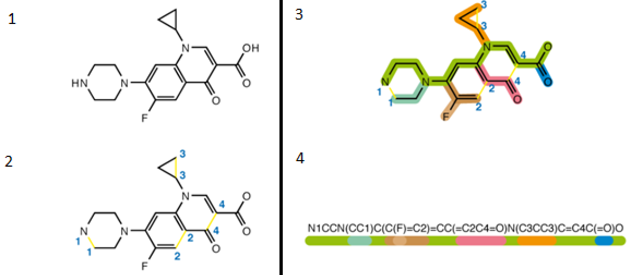
SMILES representation
Figure 8. SMILES generation algorithm for Ciprofloxacin

Slide 12
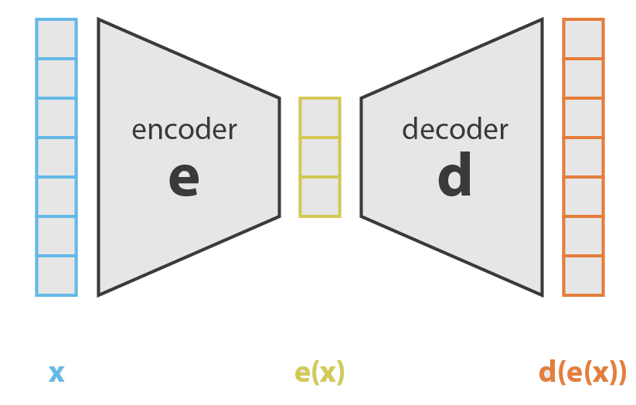
What is an autoencoder?
The encoder compress the input into a lower-dimensional code
The decoder reconstruct the output from this representation.
Figure 9. Autoencoder architecture⁴

Slide 13
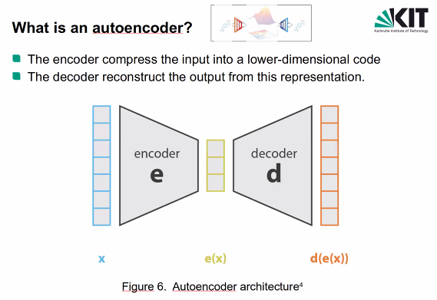
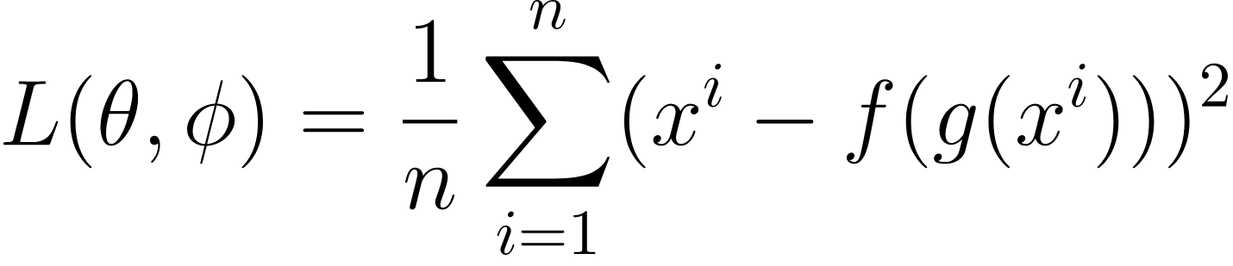
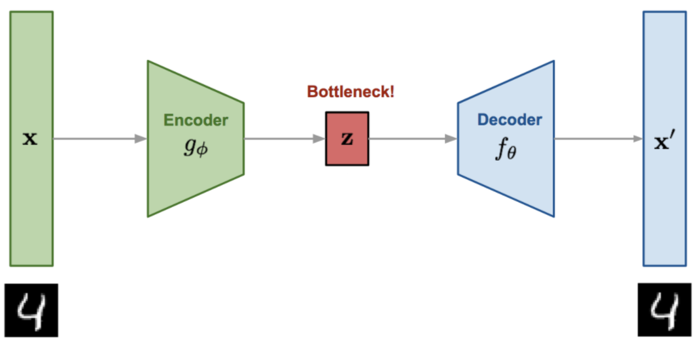
Autoencoder loss function
Loss function:
Figure 10. Convolutional autoencoder⁸

Slide 14
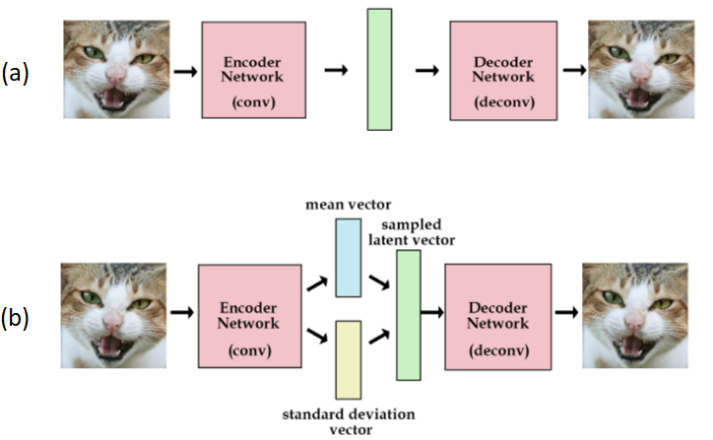
Variational autoencoder (VAE)
Figure 11. (a) Autoencoder and (b) VAE architecture⁵

Slide 15
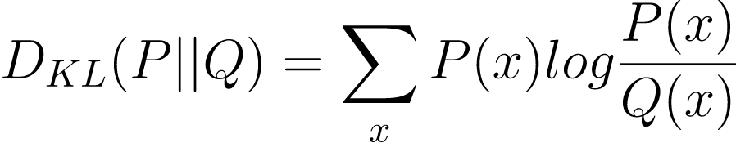
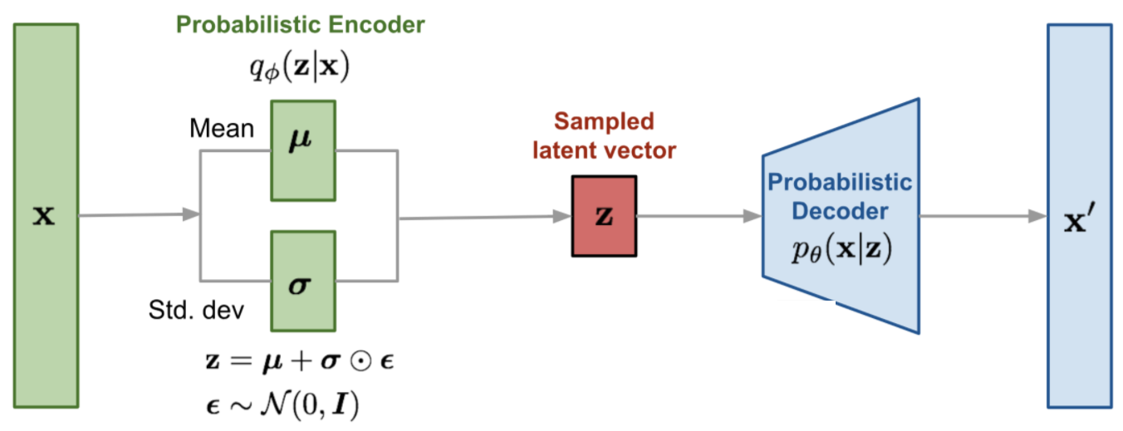
Variational autoencoder (VAE) architecture
Loss function:
with
Figure 12. VAE architecture⁸

Slide 16
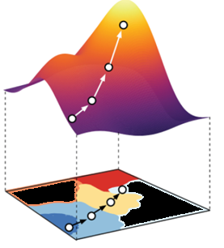
Autoencoder in latent space
For unconstrained optimization in the latent space to work ➔ Points in the latent space must decode into valid SMILES
Without this constraint ➔ The latent space learned by the autoencoder may contain large “dead areas”
Points in dead areas decode to invalid SMILES strings.
Figure 13. Latent space, with dead areas⁶
Automatic Chemical Design, 10.1021/acscentsci.7b00572

Slide 17
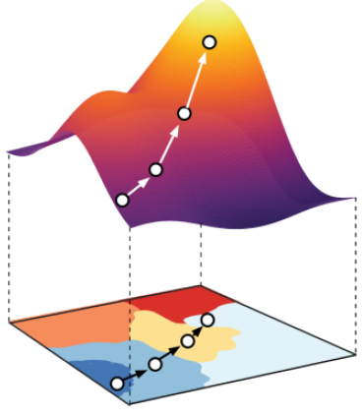
Autoencoder Vs. VAE
To help ensure that points in the latent space correspond to valid realistic molecules, they use a VAE
VAEs generalize autoencoders, adding stochasticity to the encoder
It encourages, with a penalty term, all areas of the latent space to correspond to a valid decoding
Figure 14. Latent space⁶
Automatic Chemical Design, 10.1021/acscentsci.7b00572

Slide 18
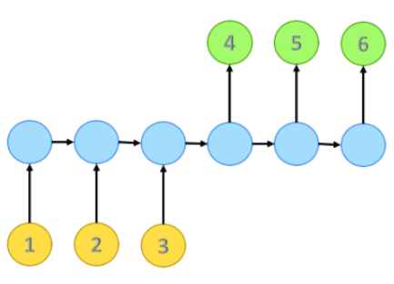
VAEs with recurrent neural network
Strings of characters can be encoded into vectors using recurrent neural networks (RNNs).
An encoder RNN can be paired with a decoder RNN to perform sequence-to-sequence learning.
The last layer of the RNN decoder defines a probability distribution over all possible characters at each position in the SMILES string.
Figure 15. RNN sequence to sequence learning

Slide 19
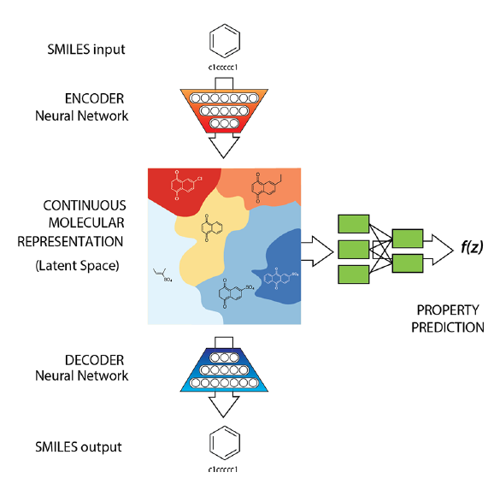
The predictor
We train the autoencoder jointly on a property prediction task
The predictor estimates chemical properties from the latent continuous vector representation of the molecule.
The regression error is added to the loss function
Figure 16. The VAE and prediction model⁶
Automatic Chemical Design, 10.1021/acscentsci.7b00572

Slide 20
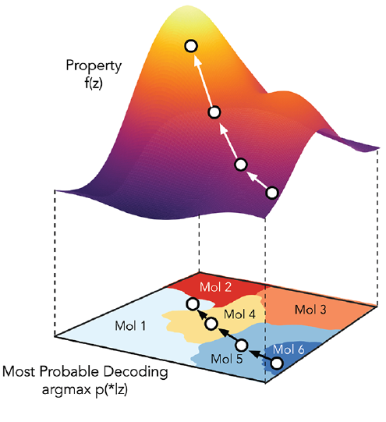
Gradient-based optimization in latent space
To find a new molecule:
1. Start from the latent vector of an encoded molecule
2. move in the direction most likely to improve the desired attribute
These new latent representations can then be decoded into SMILES strings
Figure 17. Gradient-based optimization in continuous latent space⁶
Automatic Chemical Design, 10.1021/acscentsci.7b00572

Slide 21
Experiments - Dataset
Two autoencoder VAE VAE VAE systems were trained:
QM9 data set
108 000 molecules
ZINC database
250 000 molecules
The latent space representations
156 dimensions for the QM9
196 dimensions for the ZINC
RNN encoder Vs. convolutional encoder
Good performance using convolutional encoder

Slide 22
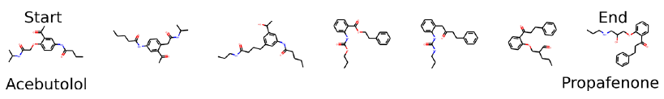
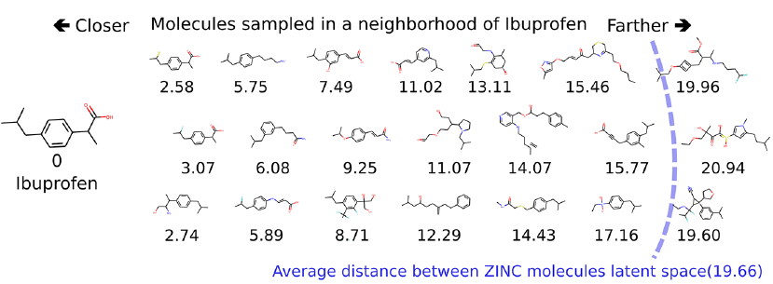
Experiments - Molecules in Latent Space
Figure 18. slerp interpolation between two molecules in latent space.⁶
Figure 19. molecules sampled near the location of ibuprofen in latent space⁶

Slide 23
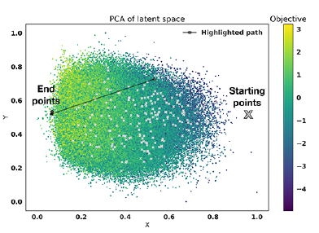
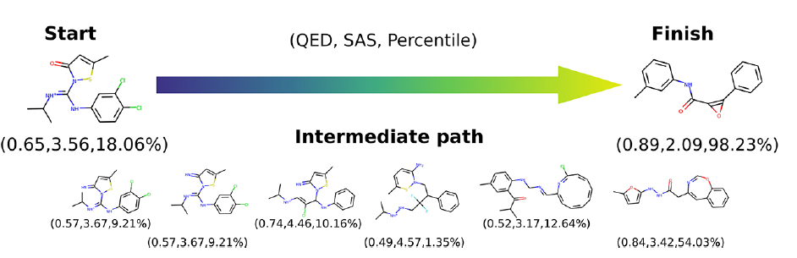
Experiments – Latent space path
Figure 20. starting and ending points of several optimization runs⁶
Figure 21. Molecules decoded along an optimization path ⁶

Slide 24
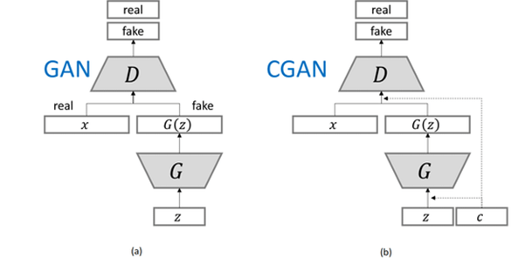
Outlook – CGAN
Could Conditional CGANs replace the VAE?
Figure 22. GAN and CGAN architecture¹¹

Slide 25
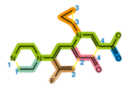
Summary
Undiscovered molecules
How can we discover new molecules?
Structure-based drug design & Ligand-based drug design
ReLeaSE
ORGAN
VAE as generative model
SMILES
Autoencoder Vs. VAE
Predictor
Experiments
Molecules in latent space
Why are some hand sanitizer gels so sticky? (viscosity)
What data is need? What model could be used? Any ideas?
Notes:
I started by motivating around the hand sanitizer molecule Exposed the Presented 3 different AI approaches - ReLeaSE the reinforcement based approach - ORGAN the GAN and RL based approach - VAE as generative models Then I presented the experiments and results of the approach Now I have a question for you, what data is needed? What model could be used?

Slide 26
References (1)
[1] Kim, S.; Thiessen, P. A.; Bolton, E. E.; Chen, J.; Fu, G.; Gindulyte, A.; Han, L.; He, J.; He, S.; Shoemaker, B. A.; Wang, J.; Yu, B.; Zhang, J.; Bryant, S. H. PubChem Substance and Compound databases. Nucleic Acids Res. 2016, 44, D1202−D1213.
[2] Polishchuk, P. G.; Madzhidov, T. I.; Varnek, A. Estimation of the size of drug-like chemical space based on GDB-17 data. J. Comput. Aided Mol. Des. 2013, 27, 675−679.
[3] Pyzer-Knapp, Edward O., Changwon Suh, Rafael Gómez-Bombarelli, Jorge Aguilera-Iparraguirre and Alán Aspuru-Guzik. “What Is High-Throughput Virtual Screening? A Perspective from Organic Materials Discovery.” Annual Review of Materials Research 45 (2015): 195-216.
[4] Joseph Rocca ” Understanding Variational Autoencoders (VAEs)” 2019 https://towardsdatascience.com/understanding-variational-autoencoders-vaes-f70510919f73#:~:text=variational%20autoencoders%20(VAEs)%20are%20autoencoders,order%20to%20ensure%20a%20better

Slide 27
References (2)
[5] Kevin Frans “ Variational Autoencoders Explained“ 2016 https://kvfrans.com/variational-autoencoders-explained/
[6] Gómez-Bombarelli, R., Wei, J. N., Duvenaud, D., Hernández-Lobato, J. M., Sánchez-Lengeling, B., Sheberla, D., Aguilera-Iparraguirre, J., Hirzel, T. D., Adams, R. P., & Aspuru-Guzik, A. (2016). Automatic chemical design using a data-driven continuous representation of molecules. ArXiv E-Prints, earXiv:1610.02415.
[7]Aditya Sharma “Conditional GAN (cGAN) in PyTorch and TensorFlow“ 2021 https://learnopencv.com/conditional-gan-cgan-in-pytorch-and-tensorflow/
[8] Victor E. Irekponor “Mathematical Prerequisites For Understanding Autoencoders and Variational Autoencoders (VAEs): Beginner Friendly, Intermediate Exciting, and Expert Refreshing.“ https://medium.com/analytics-vidhya/mathematical-prerequisites-for-understanding-autoencoders-and-variational-autoencoders-vaes-8f854025390e
[9] Popova, M., Isayev, O., & Tropsha, A. (2018). Deep reinforcement learning for de novo drug design. Science Advances, 4(7), eaap7885.

Slide 28
References (3)
[10] Lima Guimaraes, G., Sanchez-Lengeling, B., Outeiral, C., Cunha Farias, P., & Aspuru-Guzik, A. (2017). Objective-Reinforced Generative Adversarial Networks (ORGAN) for Sequence Generation Models. arXiv e-prints, arXiv:1705.10843.
[11] Gerasimos Spanakis, (2018) LoGAN: Generating Logos with a Generative Adversarial Neural Network Conditioned on color

